Slide 1
The Messiness
Of Software Development
Creative Commons Attribution-NonCommercial-ShareAlike 3.0 Unported License. http://creativecommons.org/licenses/by-nc-sa/3.0/
Written by Rachel J. Morris, last updated 2015-01-24

Slide 2
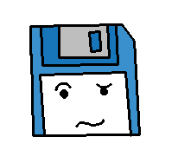
What could possibly go wrong?

Slide 3
Errors
Syntax errors are easy to protect against – your program won't build if there is a syntax error in the code.
Logic errors can be very difficult to spot, because they don't cause the program to crash or not build – the program runs, but it doesn't do that you intended for it to do.
Run-time errors can cause your program to crash, or generate errors, or otherwise make it so your program no longer functions.
This could be caused by a logic error, a user error, an error by somebody extending your original work, or by something else.
“while not done”

Slide 4
Errors
We can try to write our software so that no errors ever occur, but can you ever be certain that it is 100% bug free, or that the user will never cause an error?
There are techniques we can use to mitigate these problems.
“while not done”

Slide 5
Error Mitigation
Testing
We can use testing to search for run-time errors and logic errors, either by having a tester manually test the software, by writing automated tests that continue testing the software after every change, and writing unit tests that test each unit of the code (single functions, functionality, etc.)
Method
“while not done”
We can also follow certain design principles to try to minimize the likelihood of errors manifesting due to bad code, bad changes, bad process, and by ensuring code is reviewed by multiple developers before being added to the overall codebase.

Slide 6
Error Mitigation
Error Handling
We can also add code into our program to look out for errors that we know might happen, and handle it appropriately and cleanly if it does occur – so the program can still function, or at least clean up without causing problems to saved data or the system.
“Engineering”
Software can be extremely fragile, and the software engineering field is not a field like architecture, where there is a definite set of guidelines in order to ensure that the product functions, is safe, or even to ensure that development happens in a certain amount of time and with a certain budget.
“while not done”

Slide 7
Error Mitigation
Who's responsible for making sure software
functions, is secure, or at least breaks safely?
How big is the risk associated with any given product?
Social
Media
Vehicle Software
Video games
Media players
Legal Software
Medical Software
“while not done”
Organizer apps
Defense
Software

Slide 8
Error Mitigation
If an airplane's software encounters an error, it can't just reboot its system or restart its software mid-flight.
If a legal case depends on documents from a business, loss/corruption of those documents due to software failure could be costly.
For personal software, it could just be losing some data or some time, but low-quality software can lead to loss of money, privacy, security, or even life.
“while not done”

Slide 9
Luckily...
Nobody's life is depending on our programming assignments.
“while not done”
But what can we do to try to build stable software?

Slide 10
Handling Errors

Slide 11
Sources of errors?
Trying to open a file that doesn't exist.
A memory access violations.
Invalid math (Division by 0...)
Not enough memory.
Receiving a data type as input that is incompatible with the data type we're expecting

Slide 12
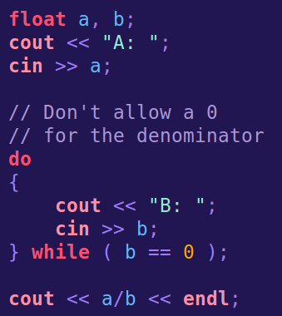
What can we do?
We could simply check against invalid input...
But are we always going to know what input is invalid ahead of time?
What if we're using someone else's code and there's an error?
How do we detect it?
What do we do when the program has an error?

Slide 13

Old school...
An old way of handling errors is to return an error code – 0 for “fine” and other numbers for other problems (which usually the programmer “would” know...)
The user can't tell what went wrong and can't hope to try to avoid the problematic behavior, or fix it!

Slide 14
Another way to report errors
We can write our software to handle errors so that:
An error happens. An exception is thrown.
The caller knows that exceptions could occur while using this code, so it tries the code, and is ready with a catch for exceptions.
The catch code looks at the exception and safely handles the exception.

Slide 15
Another way to report errors
When an exception is caught, control of the program is transferred to a handler.
But, to detect any thrown exceptions, we have to be “listening” for it, with the try keyword.
The C++ Standard Library provides an exception class object, which we can extend if we want.
http://www.cplusplus.com/reference/exception/exception/

Slide 16
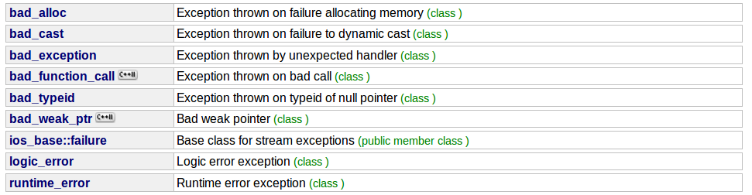
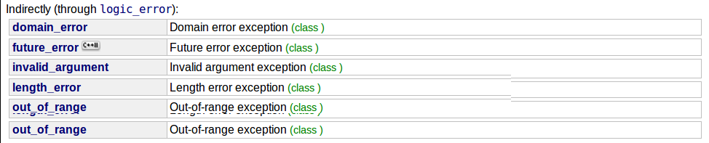
C++ Standard Library Exception
http://www.cplusplus.com/reference/exception/exception/

Slide 17
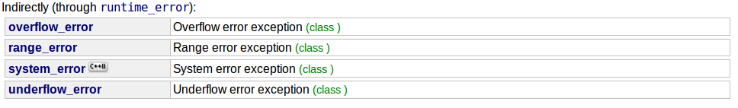
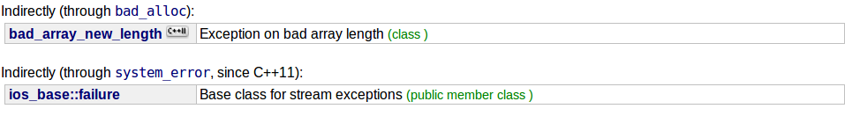
C++ Standard Library Exception
There are a lot of types of exceptions!
http://www.cplusplus.com/reference/exception/exception/

Slide 18
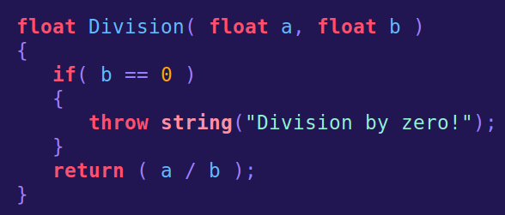
Writing a throw
Say that we're writing a function where there could potentially be a division by zero. We need to throw an exception if this happens.
We could throw different data types – an integer for an error code, a string for a simple message, or an exception object from the Standard Library.

Slide 19
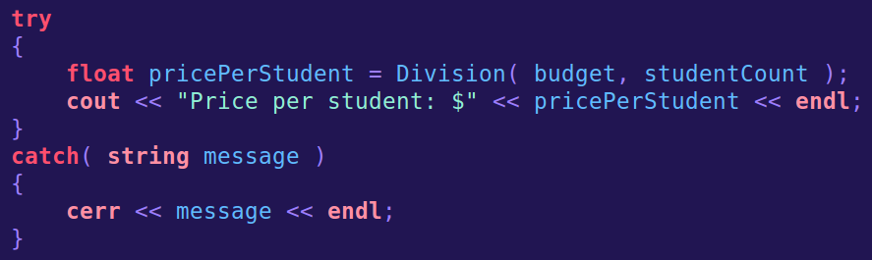
Writing a throw
Then, when our function is put into practice, it would need to have try surrounding it.
The catch parameter needs to match the data-type we are throwing.

Slide 20
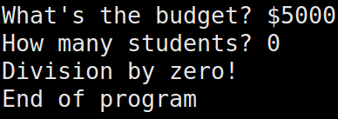
Writing a throw
Then, when our function is put into practice, it would need to have try surrounding it.
When our program runs, it will display the error message (if we want it to) then continue.

Slide 21
Try / Catch / Throw
try
Try a function or portion of code that we know has a throw command within it.
catch
Handle the error we receive. There can be multiple catches for different types of exceptions.
throw
From within code that may cause a problem, we throw if that problem is detected.

Slide 22
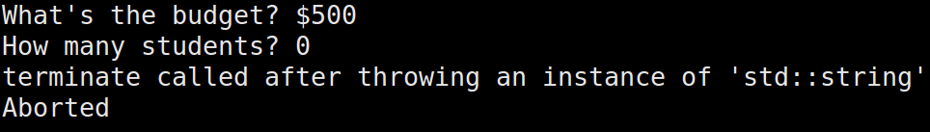
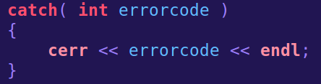
Try / Catch / Throw
If you do not catch an exception, the default behavior for C++ is to terminate the program.
Even if you have a catch, it might not be looking for the right type of exception. For the example above, it is looking for a catch to handle a string, but the program was modified to only handle an int...

Slide 23

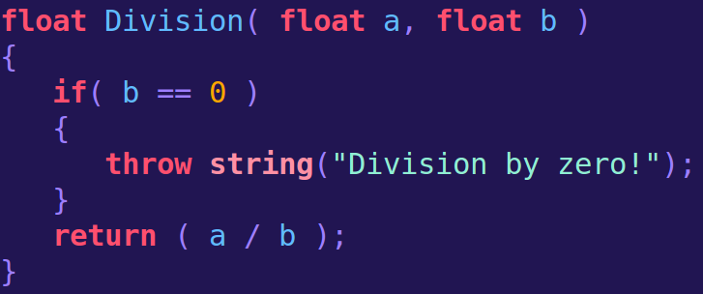
Specifying that your function might “throw up”
You can specify that your program might throw, and what kind of exceptions it will throw, during the function declaration / function definition
Nothing specified - This function might throw anything.
Declaration
Definition

Slide 24
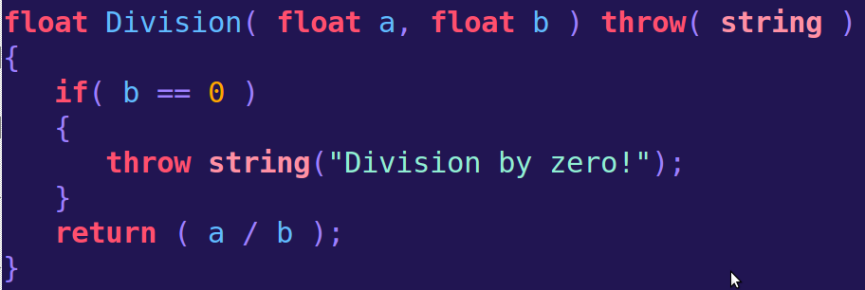
Specifying that your function might “throw up”
You can specify that your program might throw, and what kind of exceptions it will throw, during the function declaration / function definition
Only a string will be thrown

Slide 25
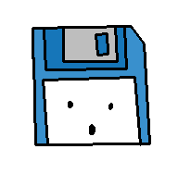
Bad Practice
Don't wrap your entire program in a try / catch block!
Try to wrap your try / catch around the smallest amount of code possible!

